Slide 1
State-Meaning,Elements,Nature and Functions
Sate is the central theme of Political Science
As a concept, the state came into frequent use during 16th and 17th centuries (Machiavelli)
Highest form of all human associations
External organization fulfilling the permanent and universal necessities of human personality
Provides environment for self realization and self development of man
Unique organization that represents the entire community
An organization that claims monopoly of the use of violence against a group or population

Slide 2
State
The state is a political association within defined territorial borders, and exercises authority through a set of permanent institutions.
The classic definition of the state in international law is found in the Montevideo Convention on the Rights and Duties of the State(1933).Acc. To Art. 1 of this Convention, the state has four features:
A defined territory
A permanent population
An effective government
The capacity to enter into relations with other states.

Slide 3
Meaning and definitions
State has been used both as a ‘normative’ and as a ‘descriptive’ concept.
In normative sense, its emphasis as something natural and a necessary institution…glorifying the role of nature in its creation
in descriptive sense…state is a political association fulfilling certain role and obligations
Aristotle- ‘…union of families and villages having for its end a perfect and self-sufficient life by which we mean a happy and honourable life’

Slide 4
Definitions…
Holland- ‘State is a numerous assemblage of human beings, generally occupying a certain territory among whom the will of the majority or an ascertainable class of persons is by the strength of such a majority or class made to prevail against any of their member who opposes it’
Hall- ‘The marks of an independent state are that the community constituting it is permanently established for a political end, that it posses a definite territory and that it is independent of external control’.
Phillimore- ‘State for all purposes of international law is a people prominently occupying a fixed territory, bound together by common laws and custom into one body politic, exercising through the medium of an organized government, independent sovereignty and control over all persons and things within its boundaries, capable of making war and peace and of entering into all international relations with the communities of the globe…’

Slide 5
Essential elements of state
Population
Fixed Territory
Government
Sovereignty
Other elements are:
Recognition
All-comprehensiveness

Slide 6
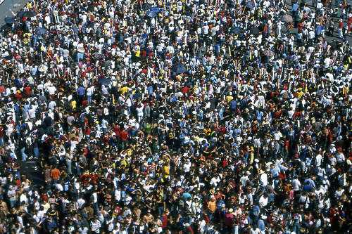
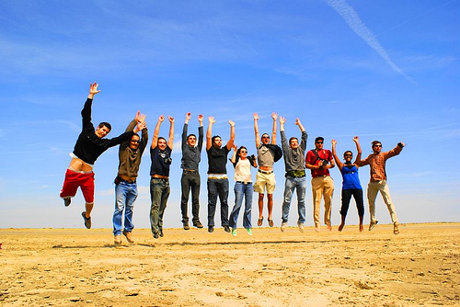
Elements of a state
People
- The mass of the population living within the state.

Slide 7
Population…
Full members of state are called citizen and they enjoy the benefit and protection.
It includes both, who rule, and those who are ruled.
No uniform principle concerning the population of state
Political speculation concerning size of population as old as political science
Plato-5040
Aristotle-…state…large enough to be self sufficient…and small enough to be well governed
Rousseau-10,000—’suitable relation between territory &Population’..believed … ‘Compact state’ i.e. small state proportionately strong than a large one.

Slide 8
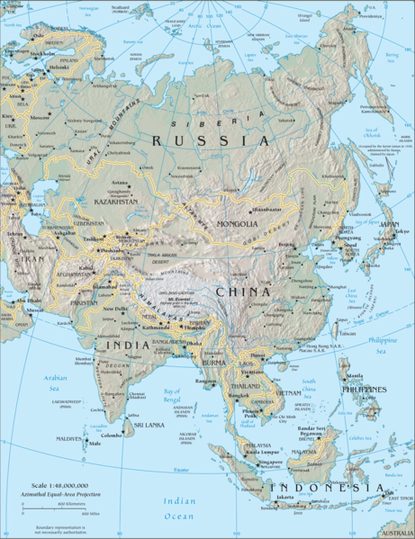
Elements of a state
Territory
- demarcated area that rightly belongs to the population

Slide 9
Fixed Territory…
Includes not only land but sub soil rights,air space and part of sea.
The borders of state limits its territorial jurisdiction.
No two states can have jurisdiction over the same territory.
The size of the territory of state cannot be fixed
Engels- ‘The state comes into being when its population settles in a fixed territory’
John Seeley- ‘Fixed territory not essential to constitute state’.

Slide 10
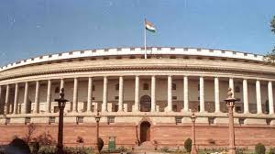
GOVERNMENT

Slide 11
the legal instrument through which the will of the state is expressed
A machinery which carries out the rules and regulations of the legal association
Hobbes- ‘no civilized life is possible without government’
Absence of government means anarchy
No particular type of govt. is essential. It depends largely upon the nature of the state, which, in turn, depends mainly on the outlook of people, their character, and the political philosophy

Slide 12
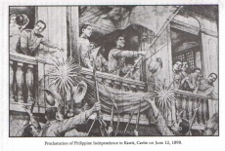
“sovereignty”
Internal – power of the state to rule within its territory
External – the freedom of the state to carry out its activities without subjection to or control by other states.

Slide 13
Sovereignty…
Hallmark of the modern state
It distinguishes state from all other human association
Power of the state to compel obedience to its will
In international sphere, state is a juridical person
Full control over her external affairs and does not recognize any outside authority as bits superior

Slide 14
In nutshell
Population and territory as the physical/material basis of the state
Government and sovereignty together constitute political/spiritual basis of the modern satte

